Slide 1

Notes:
As many of you know, this Advent season we’ve been in a series on John the Baptist—the eccentric prophet who was born to Elizabeth and Zechariah in their old age, just months before the birth of Jesus to Mary and Joseph. The angel Gabriel delivered messages to both of these couples. First, that John would be a great prophet and forerunner to the Messiah. And then, that Jesus of Nazareth—the Son of God—would be born to the virgin Mary through the power of God.
And so, the role of John the Baptist is to call people to prepare our hearts for what God is going to do through his Messiah—to repent of our sins and be baptized as a sign of surrender to the coming King and his Kingdom… [NEXT SLIDE]

Slide 2
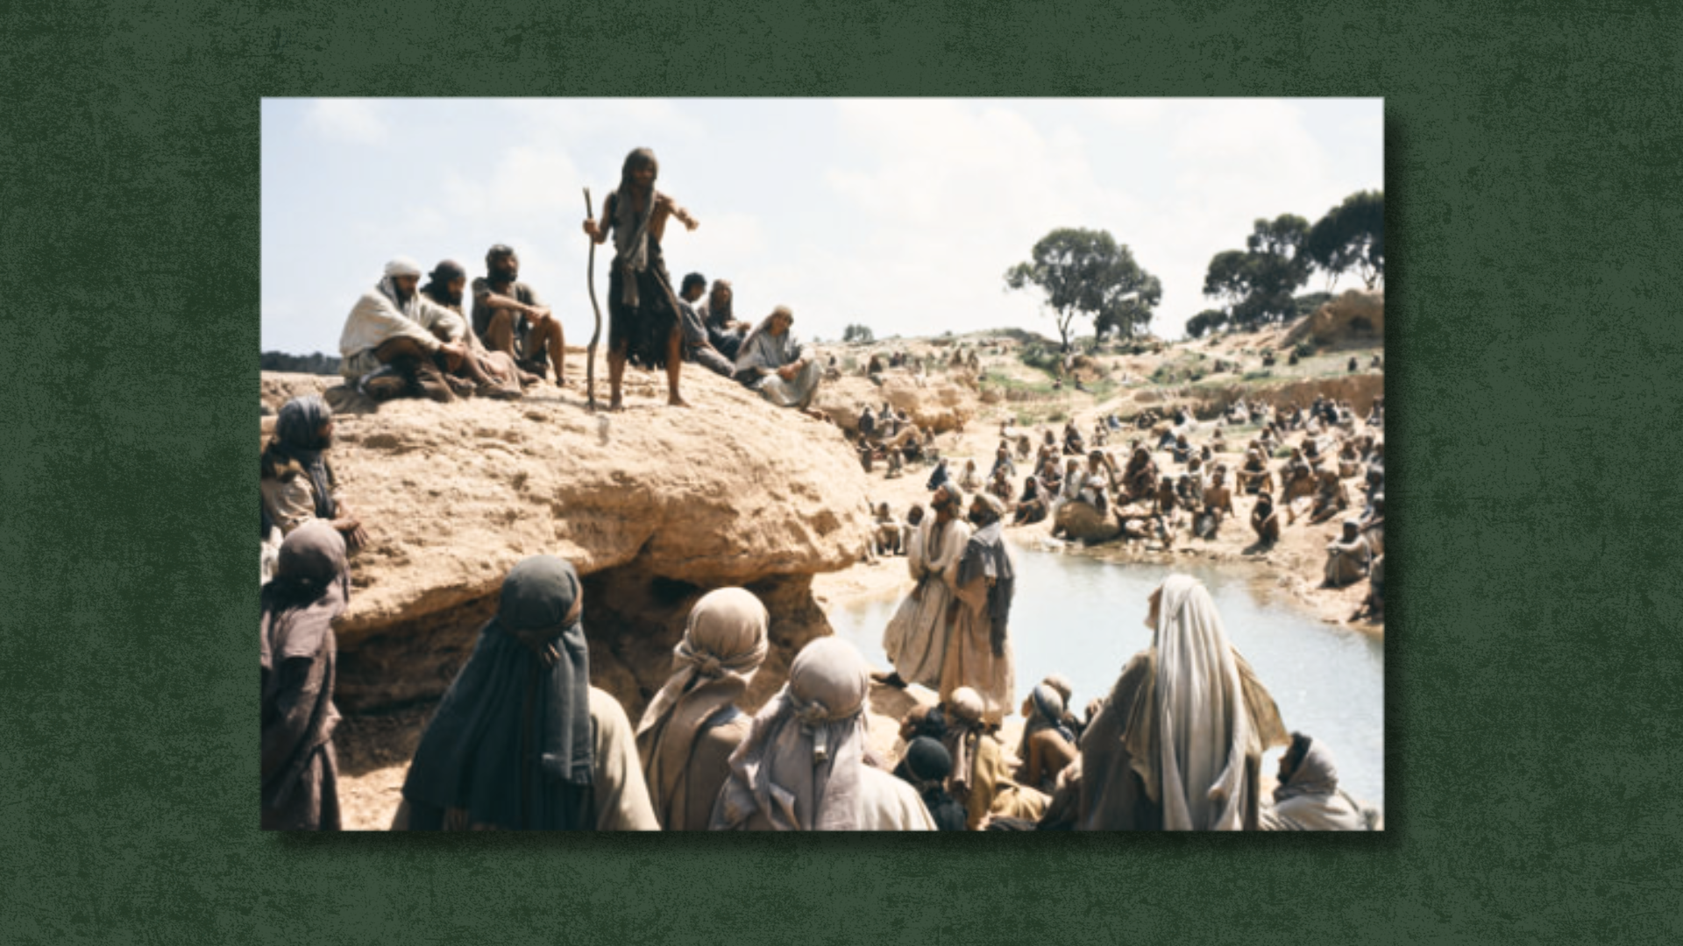
Notes:
Just like an imperial messenger would go out and prepare a city to receive a royal visitor, John the Baptist sees himself as the one who is to prepare us for the Lord’s arrival and announce the coming of the true King. And so, as we see in the OT book of Exodus, people go out into the wilderness to escape their bondage, to leave behind the noise of the world, and encounter God.
It’s a spiritual exodus, really, where God’s covenant people pass through the waters of the Jordan—the waters of cleansing, purification, of surrender, and of salvation. It’s a vivid picture of God doing a new thing. And it’s a reminder of what our own Christian baptism means today: it’s an outward symbol of an inward reality; of a life yielded to God; of hearts being prepared to enter the Kingdom that is coming; and of lives in full submission to the way of the Messiah.
And this Messiah of ours is not only the true King of Israel, he is the King of all kings and the Lord of all lords. He is the King of the cosmos—the only begotten (unique; one of a kind) Son of God, who was sent by the Father to reveal his true nature and his good purposes for creation.
And so, as we worship this evening, it’s really important that we understand what it is that we’re saying about Jesus, and what we’re actually celebrating as a church. To help us reflect on this, let’s look at our main Scripture reading together… [NEXT SLIDE]

Slide 3

Notes:
[INVITE PEOPLE TO STAND & READ JOHN 1:1-14 NLT]
This is the word of the Lord. Thanks be to God. You may be seated.
Imagine your favorite book or movie. You know the characters. You know the plot. You know how the story ends. Now imagine this: the author of that story suddenly steps into the story. Not as a narrator’s voice. Not as a footnote. Not as a distant guide. But as one of the characters—walking the roads, speaking the language, feeling hunger, fatigue, joy, and pain. The author doesn’t stand outside the story explaining it; he enters it so the characters can finally understand who he is, who they are in the story, and where the story is going.
That’s what John is telling us tonight. “In the beginning was the Word…” Jesus is not just a message from God. He is God’s own self, stepping into the story of humanity. The “Word” (logos) in Greco-Roman philosophy and thought referred to the rational principle that ordered the universe. Therefore, John declares that this Logos or Word is not an idea or force, but a person—Jesus Christ—who entered the world to show us what God is like and redeem creation.
And notice, John doesn’t say the Word visited us. He says the Word became flesh and dwelt among us; literally, “he tabernacled” with us; or "moved into the neighborhood” (MSG). My friends, the good news of Christmas is not God shouting instructions from heaven or even giving us the Bible. The incarnation is about God stepping into our mess, into the darkness, into the ordinary moments of our lives, so we would never again wonder if God understands us or if God is with us. The Author has entered the story, and everything changes. Therefore, Christmas is not a myth or wishful thinking—it’s about the claim that ultimate meaning took on flesh and entered our world.
And there are plenty of examples where this cosmic truth shows up through our modern day stories and myths; where there are allusions and echoes of the Biblical narrative. That’s because the cosmic truth bubbles up from within us and reflects the deepest longings of our heart. Stories like the Lord of the Rings, the Chronicles of Narnia, Superman, and more recently, one of my personal favorites… Tron… [NEXT SLIDE]

Slide 4
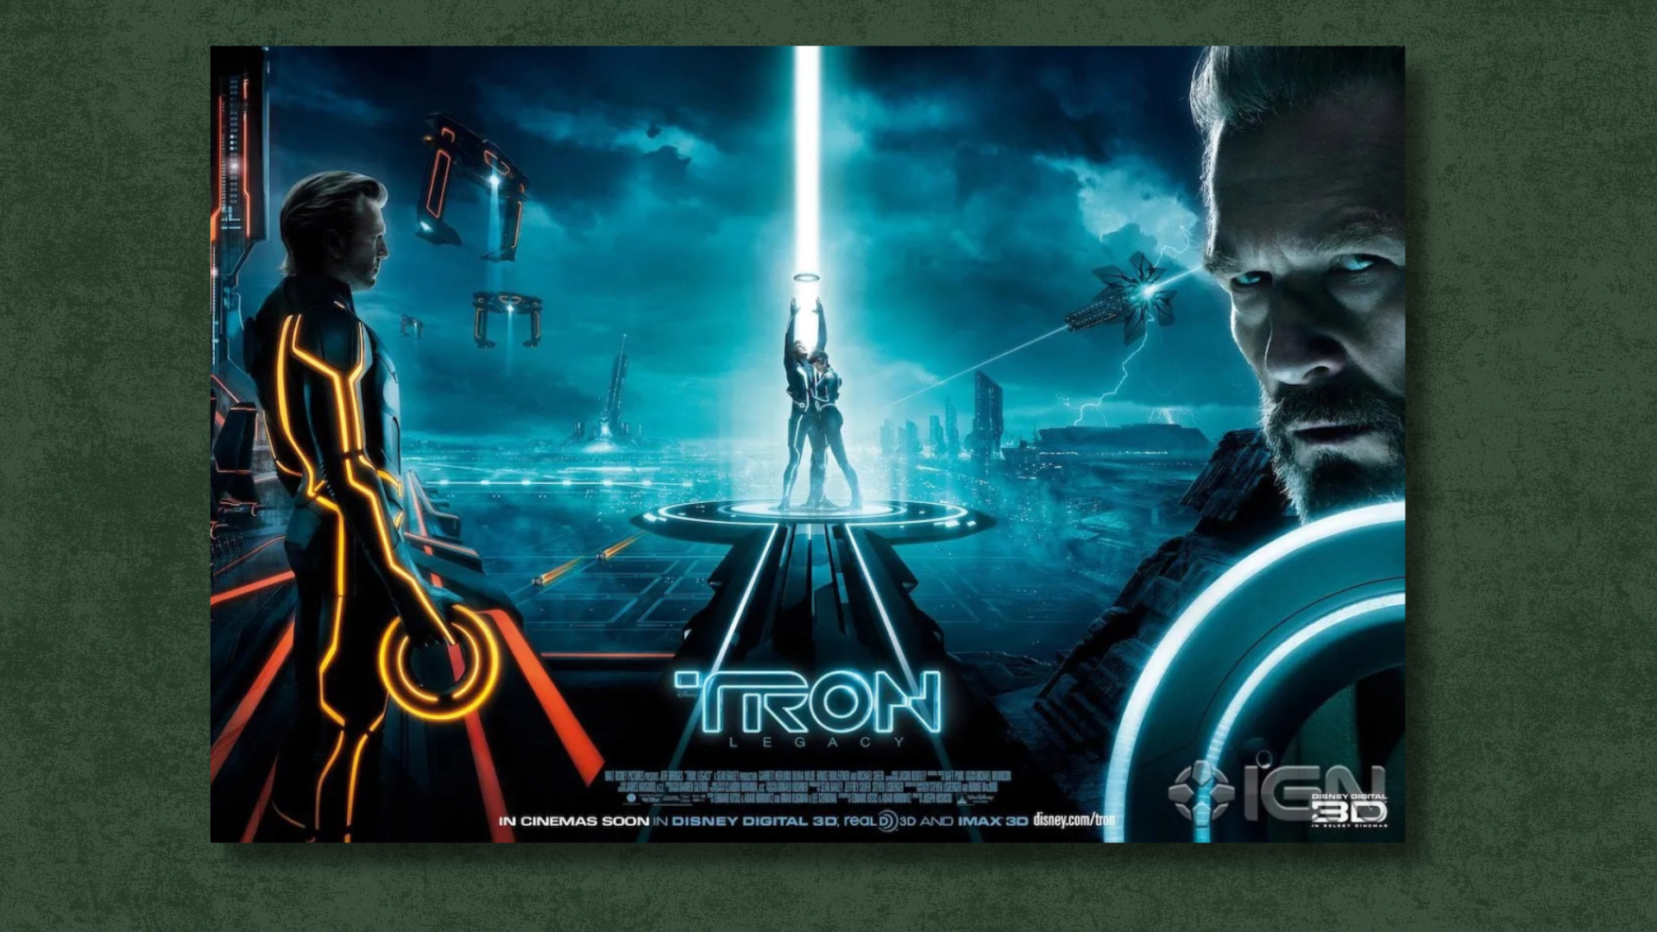
Notes:
[BRIEF COMMENTS]
In the movie Tron: Legacy, a brilliant creator named Kevin Flynn designs a digital world called the Grid. But something goes wrong. The world becomes corrupted, broken from its original purpose. Flynn could have shut it down from a distance. He could have sent instructions. He could have abandoned it altogether. Instead, he enters his own creation. He takes on its limits, lives inside its danger, and ultimately gives his life so his son—and the world he made—can be saved.
That’s the story John tells us at Christmas. “In the beginning was the Word… and the Word became flesh and dwelt among us.” God doesn’t fix the world from afar. He enters it. He takes on flesh. He steps into the darkness. Christmas Eve is the night the Creator enters His creation—not to destroy it, but to redeem it. And by taking on flesh, the Son, Jesus, has become One with the material world… forever. His being born in a manger in human flesh is not a costume or a skin-suit—his incarnation and resurrection tell us that God has forever married himself to his creation.
So… here are some key points to consider this Christmas Eve… [NEXT SLIDE]

Slide 5
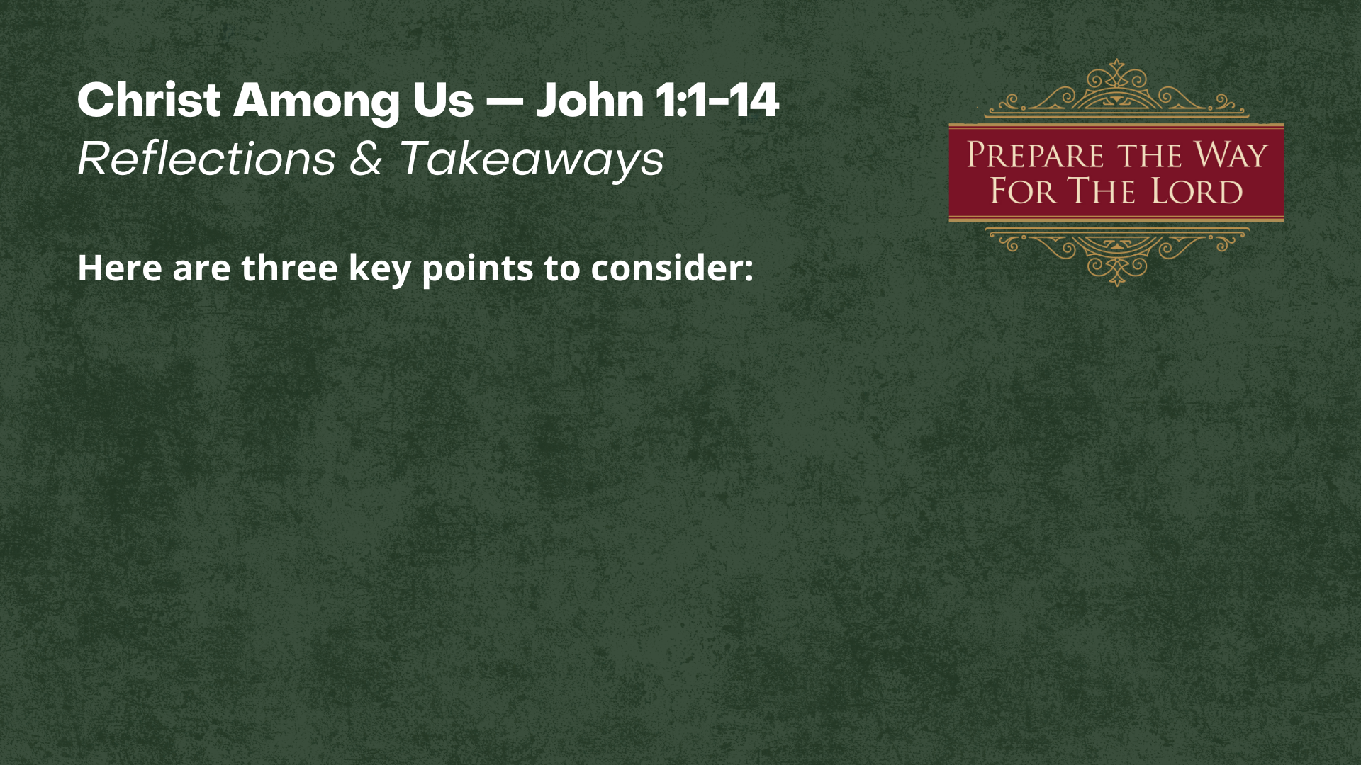

Slide 6
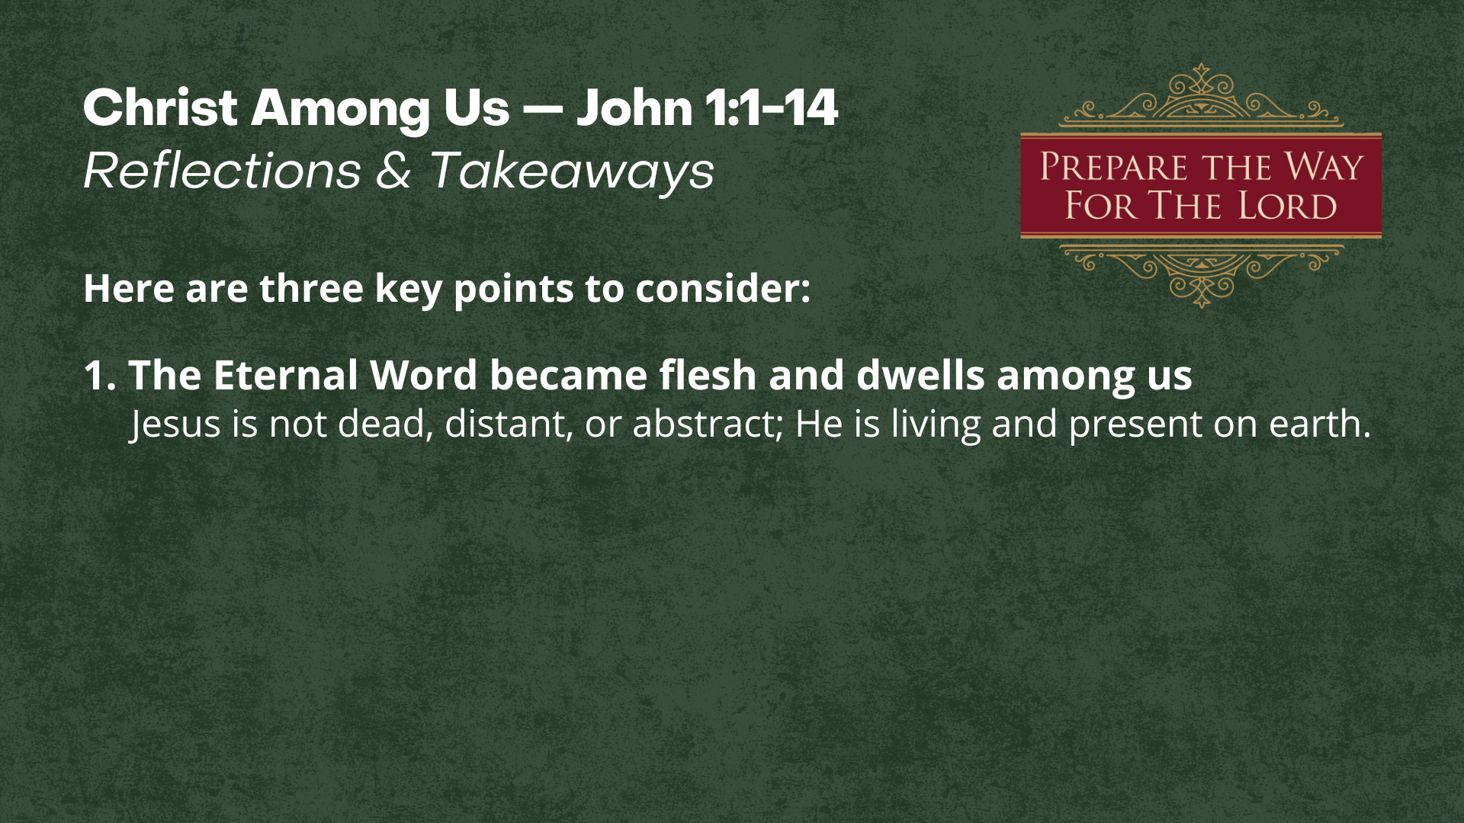

Slide 7
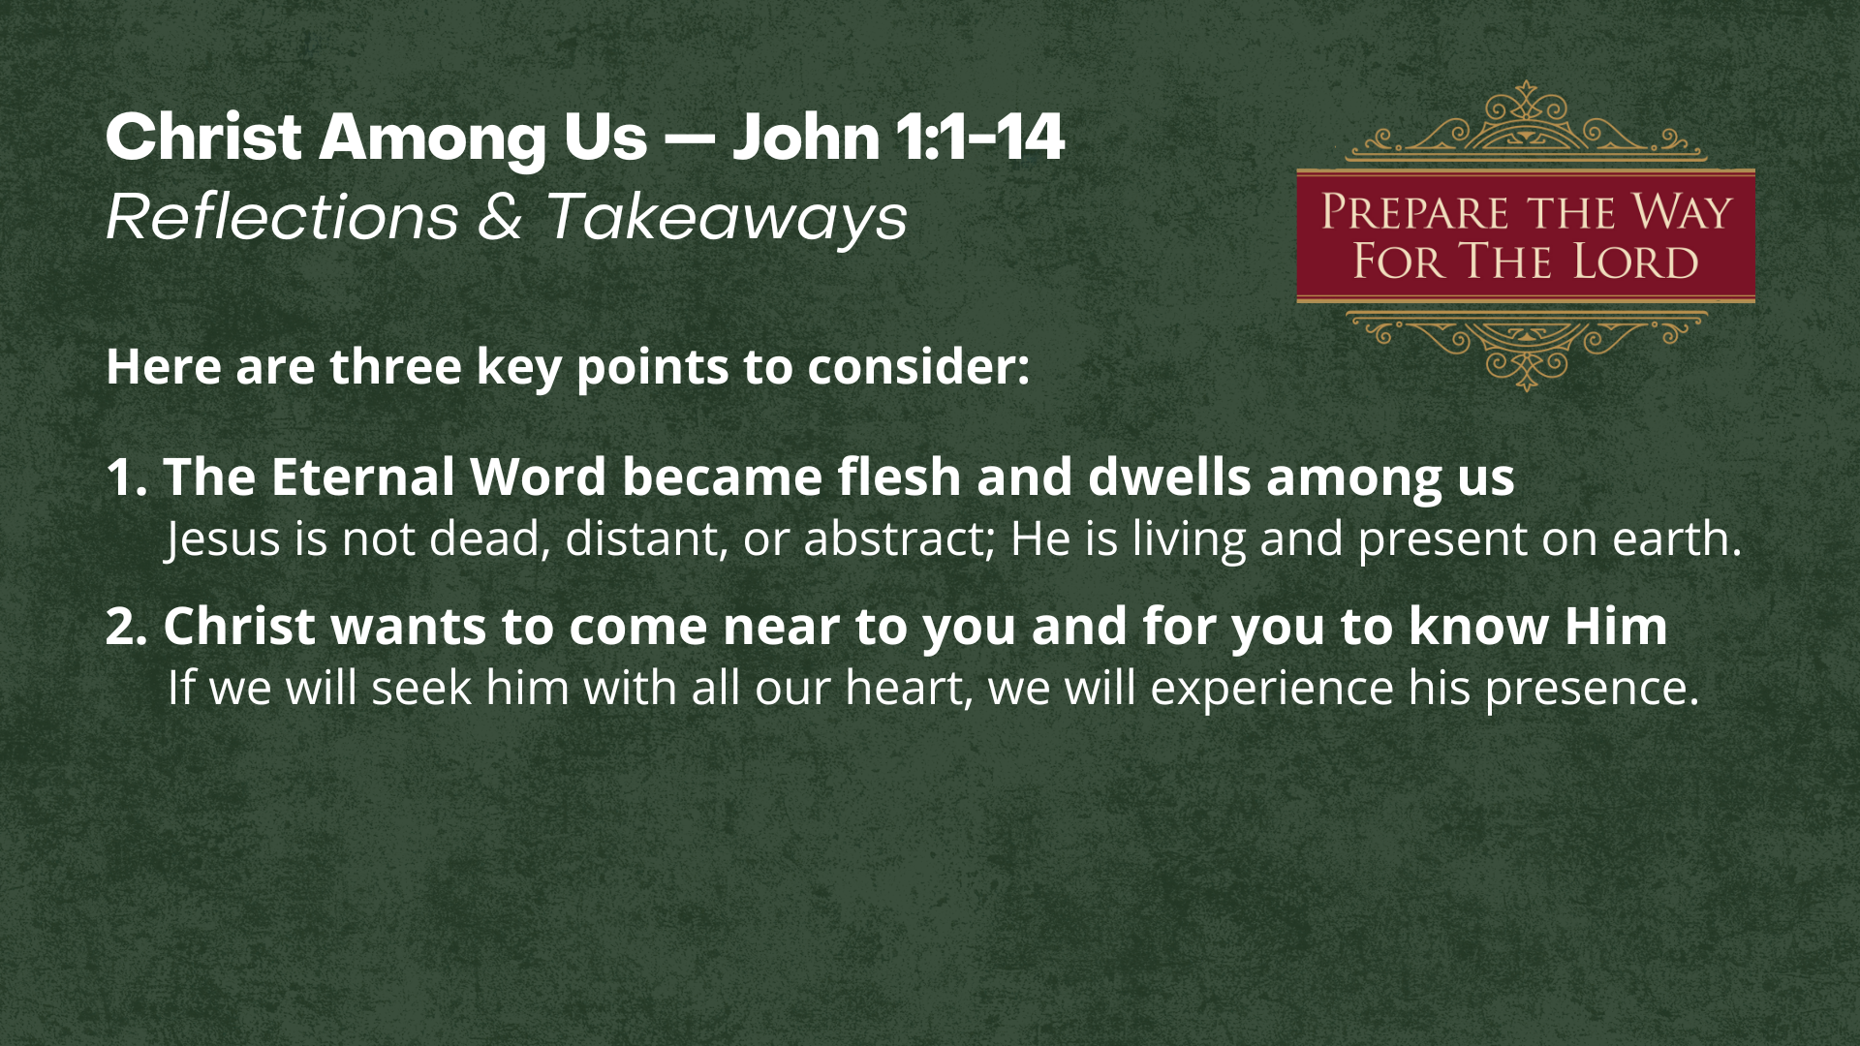

Slide 8
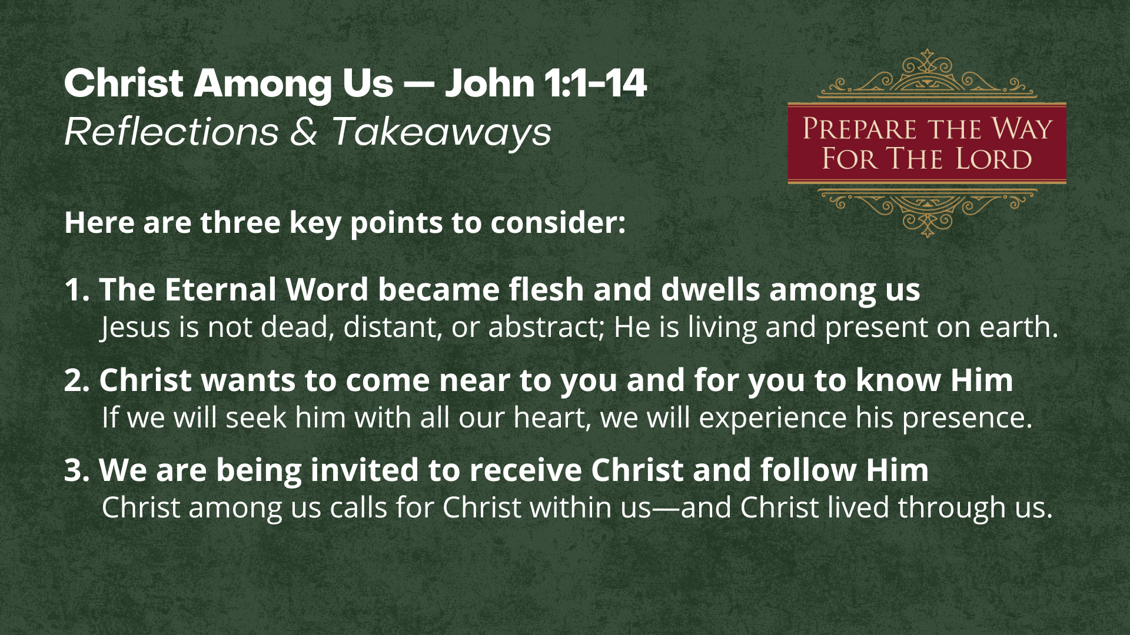
Notes:
[READ EACH POINT & BRIEFLY COMMENT]
1. The Eternal Word became flesh and dwells among us
Jesus is not dead, distant, or abstract; He is living and present on earth.
2. Christ wants to come near to you and for you to know Him
If we will seek him with all our heart, we will experience his presence.
Jer. 29:13 – “You will seek me and find me when you seek me with all your heart.”
3. We are being invited to receive Christ and follow Him
Christ among us calls for Christ within us—and Christ lived through us.
Finally, here are some questions to help us respond together… [NEXT SLIDE]

Slide 9
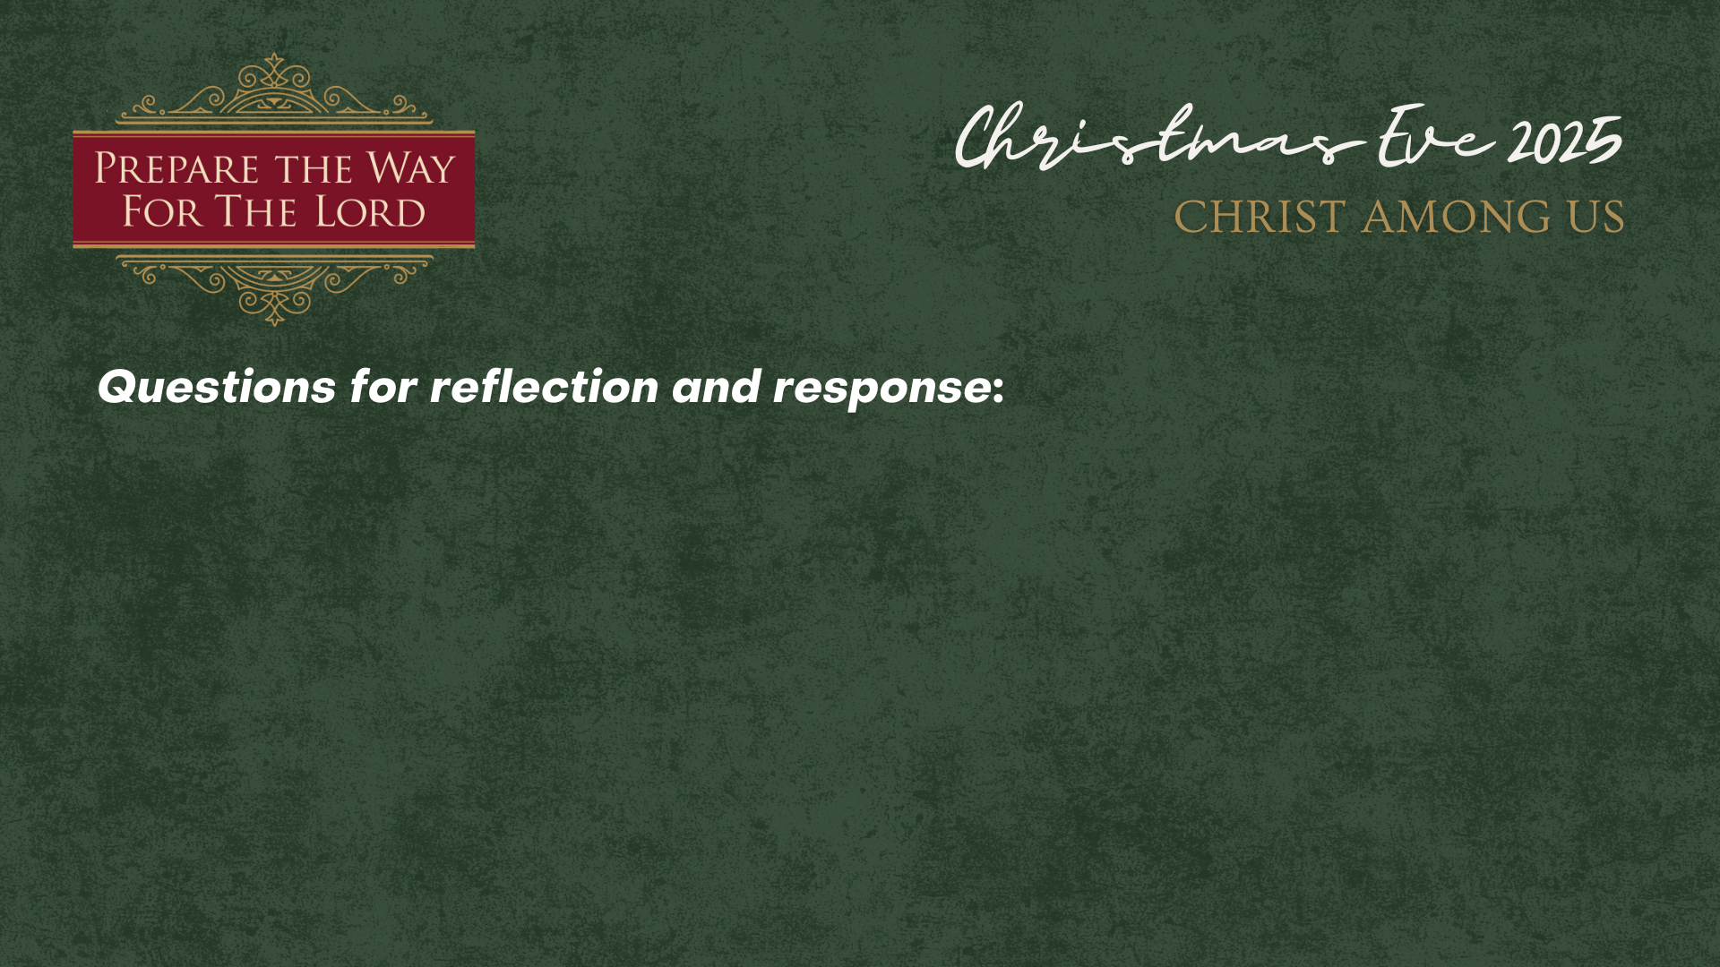

Slide 10
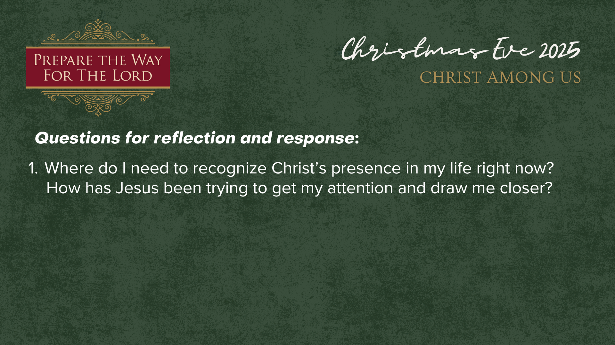

Slide 11
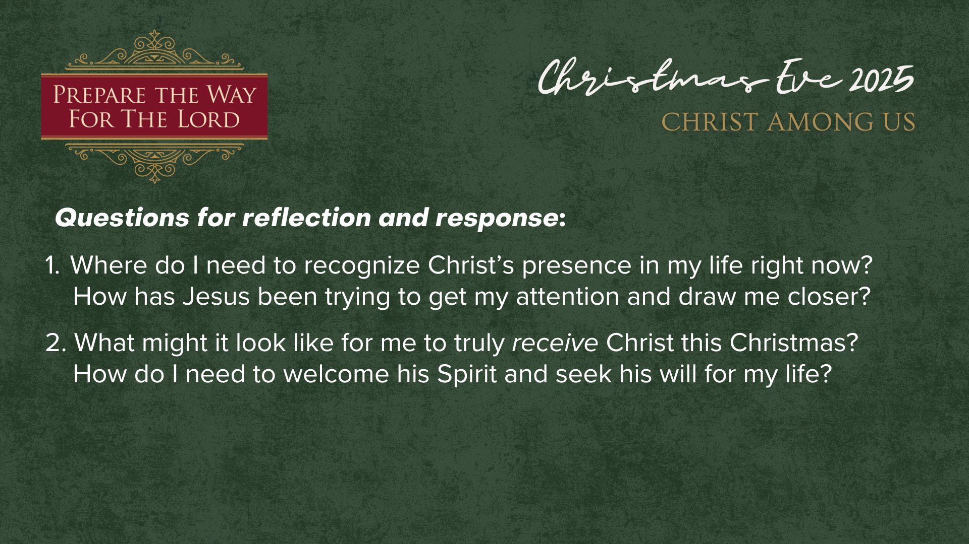

Slide 12
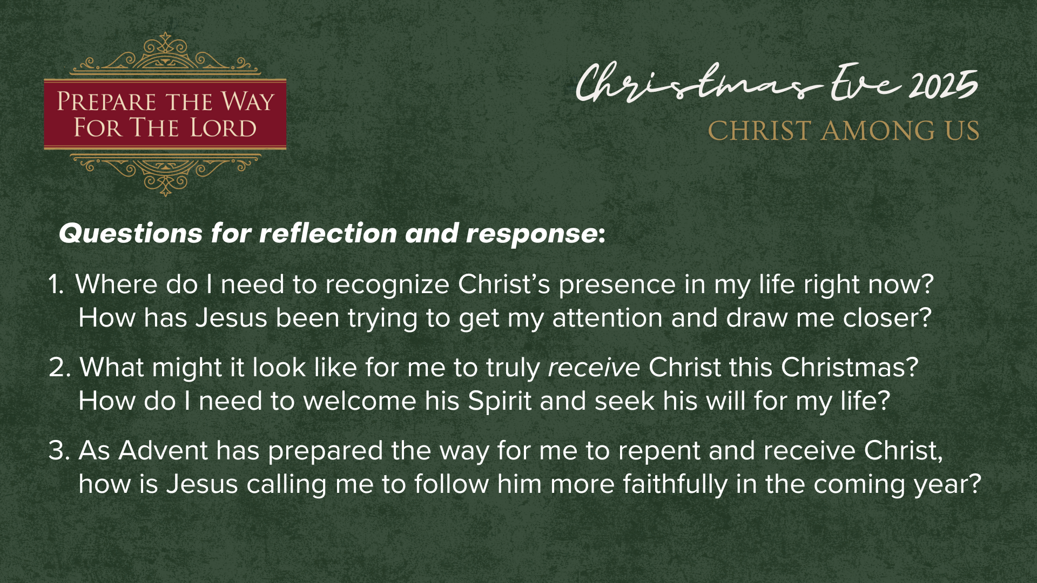
Notes:
[READ QUESTIONS & COMMENT]
Where do I need to recognize Christ’s presence in my life right now? How has Jesus been trying to get my attention and draw me closer?
What might it look like for me to truly receive Christ this Christmas? How do I need to welcome his Spirit and seek his will for my life?
As Advent has prepared the way for me to repent and receive Christ, how is Jesus calling me to follow him more faithfully in the coming year?
Let’s take a moment now to bow our heads in silence as we listen for what the Spirit is saying to us through our surrendered hearts and minds… [NEXT SLIDE]

Slide 13
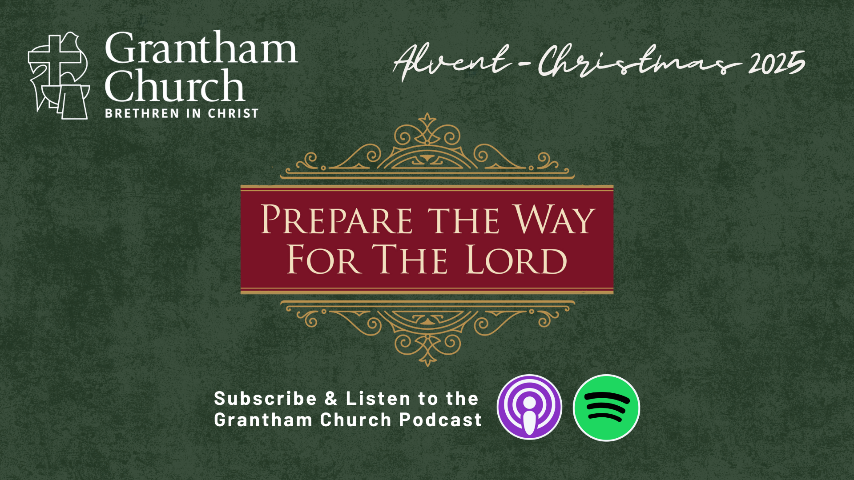
Notes:
[MOMENT OF SILENCE]
Gracious God,
We thank you that the Word became flesh and dwelt among us.
Open our hearts to receive Christ anew this night,
that his light may shine in our lives and through us into the world.
Help us to follow the way that has been prepared,
walking in grace, truth, and love.
We pray in the name of Jesus, Emmanuel—God with us.
Amen.
[CANDLE LIGHTING INSTRUCTIONS]
As we light these candles, let us remember that the true Light has come into the world—and we receive that Light so it may shine through us to others.

